Slide 1
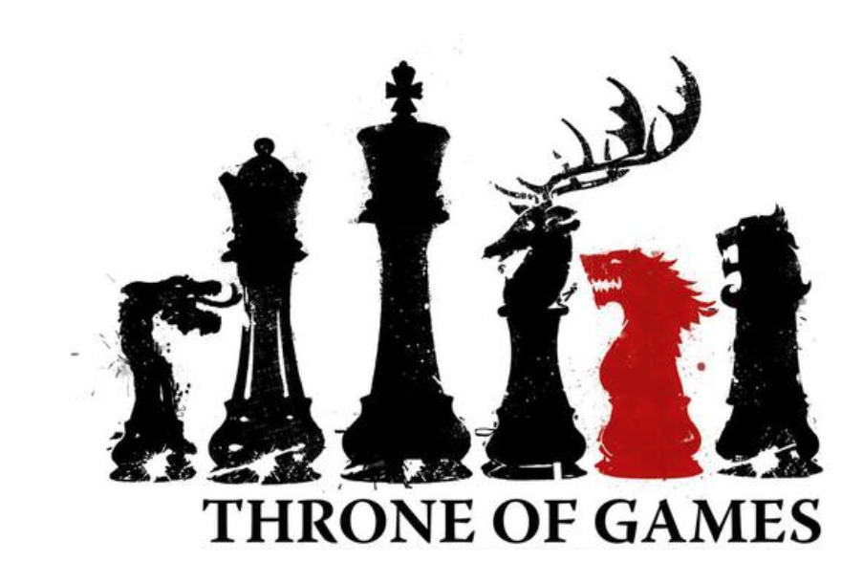
Cass Van Gelder
Scrum Master, CSM, CSPO, CSP-SM, CSP-PO

Slide 2

Who Are You?
Notes:
Get people to introduce themselves, where they are from, what they hope to accomplish. Afterwards, form alliances/teams

Slide 3
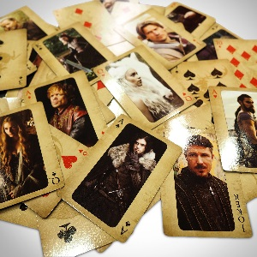
Ye Olde Qualities of
Games
Games

Slide 4
Ye Olde Qualities of Games
Voluntary participation
Way to receive feedback on play
Goal
Set of rules
Notes:
Game qualities (Game 1 – Write and Share – team members write down the game qualities as they are covered, then each takes a turn talking about what one quality means) (5 minutes)
Voluntary participation
Way to receive feedback on play
Goal
Set of rules

Slide 5

Types of
Games
Games
Notes:
Game types (Game 2 – Say and Repeat – team members repeat each type 3 times as it is covered, then all together at the end) (5 minutes)
Competitive
Cooperative
Finite
Infinite

Slide 6
Types of Games
Competitive
Cooperative
Finite
Infinite
Notes:
Game types (Game 2 – Say and Repeat – team members repeat each type 3 times as it is covered, then all together at the end) (5 minutes)
Competitive
Cooperative
Finite
Infinite

Slide 7

Game Goals
To Be on the Iron Throne, Duh?
Don’t Ask Me … I Know Nothing. To have More Wine than I Can Drink.
Notes:
Game 3 – team members decide what problem their new game will solve and what behaviors they want their players to have afterwards) (10 minutes)

Slide 8


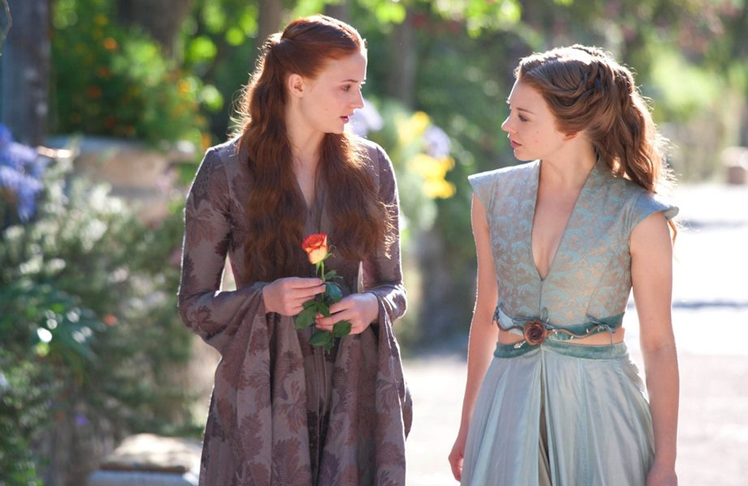

Player Personalities
To Be on the Iron Throne, Duh?
Don’t Ask Me … I Know Nothing. To have More Wine than I Can Drink.
Notes:
Player personalities

Slide 9
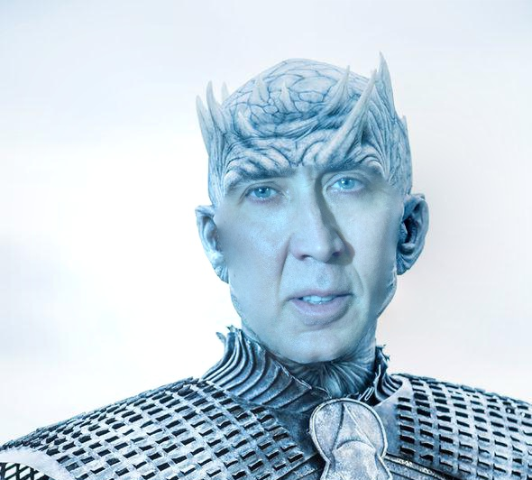
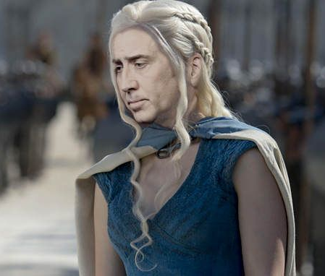
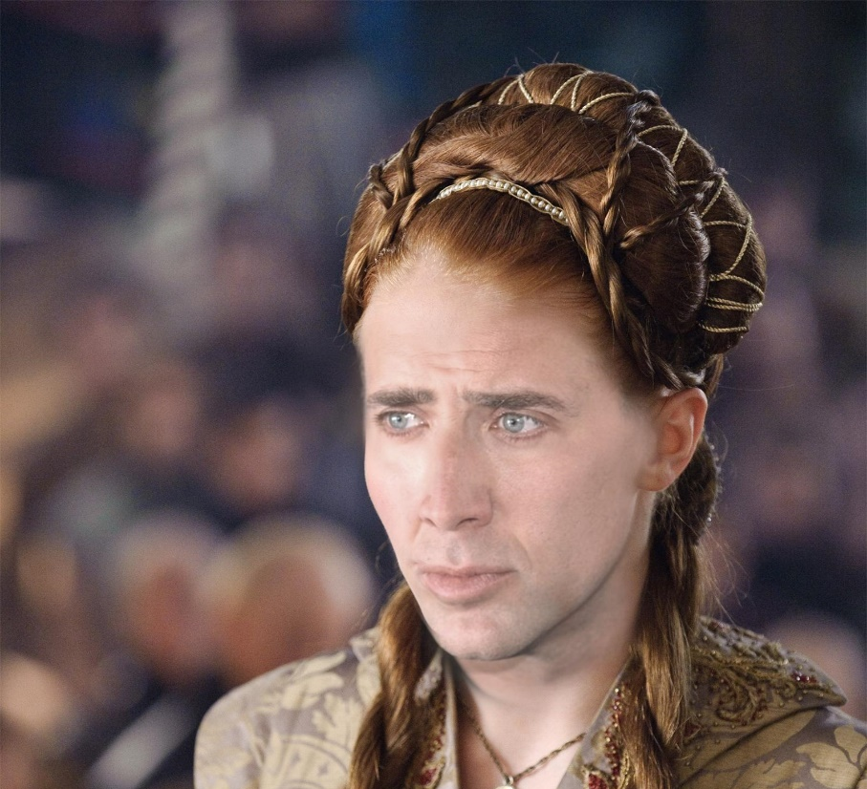
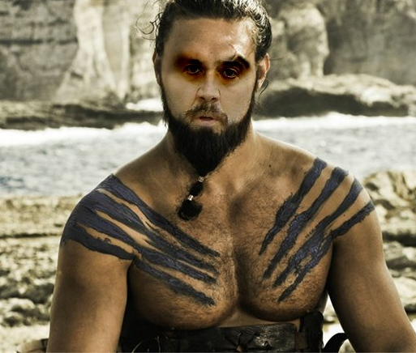
Player Personalities
To Be on the Iron Throne, Duh?
Don’t Ask Me … I Know Nothing. To have More Wine than I Can Drink.
Notes:
Player personalities (Remind yourself that not all players are the same. Otherwise, you’ll have disastrous results.)

Slide 10
Player Personalities
Killers
Achievers
Socializers
Explorers
To Be on the Iron Throne, Duh?
Don’t Ask Me … I Know Nothing. To have More Wine than I Can Drink.
Notes:
Player personalities(Game 4 – Define your Game Personality – team members decide which game personality they are. At the end, each type will stand together.) Based on the Bartle taxonomy of player types for multiplayer games (10 minutes)
Killer (Politician/"Den Mothers", Griefer (one who brings grief)
Causing mayhem among computer-controlled people and things may be fun to the Killer, but nothing amounts to the joy of pitting one's skills against an actual player-controlled opponent. For most, the joy of being a Killer results from a friendly competitive spirit. They're in it for the sport, trying to read their opponent's moves and generally acting with honor.
For others, it's more about power and the ability to hurt others or the thrill of the hunt. One such example is "ganking" or "owning", a process where the Killer takes their strong character to a place where inexperienced or weaker characters reside, and proceeds to kill them repeatedly. Once a killer finds a weaker character it becomes increasingly enjoyable to "Hunt" this character, stalking him through different zones. Repeatedly stalking and killing a weaker player adds a thrill of a certain type well described in the short story The Most Dangerous Game. Once stronger enemy players arrive to help, the Killer either waits patiently or stealthily sneaks somewhere else to repeat the process. These Killers love to have the notoriety of being someone that should be watched out for, or even better, someone to be "Killed on Sight".
In other contexts, Killers are also active in the social and economic sides of a multiplayer game. Market control appeals strongly to Killers, many of whom have a natural talent for reading markets (likely an extension of their common aptitude for sizing up strengths and weaknesses, vital to their play style). Social Killers tend to be online community leaders—or trolls. Many make the mistake of thinking Killers are antisocial or without friends, but this isn't too often the case. Even the more hostile and aggressive Killers can inspire a sort of hero-worship by less-talented Killers or Achievers; and some Killers are nice people who simply thrive on competition. In either case, a bored Killer can be a threat to the community, as their natural drive to compete and sometimes (or frequently) abrasive attitude will push them to stir up trouble even when they don't really mean to.
Achiever (Planner, Opportunist)
One of the appeals of online gaming to the Achiever is that he or she has the opportunity to show off their skill and hold elite status to others. They value (or despise) the competition from other Achievers, and look to the Socializers to give them praise. As they achieve more, they are no longer easy targets of the Killers and may enjoy their new position on the food chain. These gamers also tend to like seeing their user names at the top of scoreboards and ladder systems. Many games cater to these players by offering special titles or exclusive mounts or other in-game items to those that place in the top of the competitive ladder. Microsoft's Xbox Live utilizes the Gamerscore to reward Achievers, who can get points by completing difficult "Achievements" in the various games they purchase. They can, in turn, compare themselves to other gamers from around the world.
In many ways, the Achiever is the style of play most targeted by the MMORPG genre. In many successful MMOs, there is always something else to achieve; even when the character has reached the highest level, as there are usually rare items to obtain and objectives that were bypassed the first time around. Since Achievers can sometimes set very obscure goals for themselves, especially if they feel like they'll be (among) the first to achieve them, they may spend long periods of time engaging in a repetitive action in order to get one more award.
Socializer (Networker, Friend)
The online environment is very appealing to the Socializer, as it provides near limitless potential for new relationships. Socializers start filling up their friend lists as soon as they start meeting people, and get to know them better through private messages and sometimes even voice chat. They take full advantage of the ability to join guilds or kinships in many online games, and form fast friendships and try to help other people out. They are compatible with just about everyone; even Killers will often get along with the more respectable Socializers (or simply know better than to pick a fight that the Socializer's friends will get involved in), and the more dramatic Socializers thrive symbiotically on the chaos created by some Killers. Eventually, they will most likely be a well-known name on their particular server, either for the services they provide, or for the drama they are involved in.
Explorer (Scientist, Hacker)
The Explorer benefits much the same way as the Achiever does in the massively multi-player environment, as they are surrounded by people who will benefit from their wisdom. They often meet other Explorers and can swap experiences, and most often, Socializers do not mind listening either. Interaction with Killers is usually (though not always) negative, as hostile Killers would interfere with exploration. Most mainstream MMORPGs offer Explorers plenty of lore and rich characters to delve into. However, Explorers will often quickly become bored with any particular MMORPG when they feel it has become a chore to play, with only more of the same ahead. This is of course true to some extent of all gamers, but Explorers can be notoriously fickle, abandoning a popular game within mere weeks while spending months or years delving deeply into a less-popular one.

Slide 11

Notes:
TEAM REVEL OF NEW GAME (20 - 30 MINUTES, DEPENDING ON SIZE)
Each team revels their new game *(3-5 minutes each)*
Outside participants may ask questions and pose ideas *(2-5 minutes each)*

Slide 12

The Next Chapter
Notes:
GAMIFICATION FOLLOW-UPS (5 MINUTES)
Run and measure before and after games
Inspect and adapt game

Slide 13
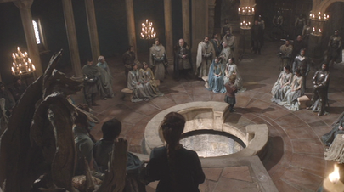
Pitfalls
Notes:
GAMIFICATION PITFALLS (5 MINUTES)
Game didn’t fit problem
Too complicated
Players aren’t engaged
Management not supportive

Slide 14
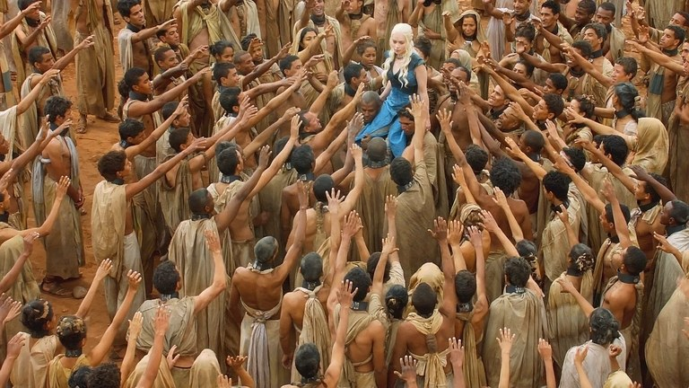
Questions?
Notes:
Questions?

Slide 15
Cass Van Gelder
Scrum Master, CSM, CSPO, CSP-SM, CSP-PO
Email: AgileIsMyName.O@gmail.com
Twitter: @AgileIsMyName_O

Slide 16


